Slide 1
Short Run: Hiring Decisions
Module 3 · Video 3
Management 405
Prof. Nico Voigtländer · UCLA Anderson

Slide 2
Module 3 · Agenda
Outline of Module 3
1
Introduction to Module 3
Video 1
2
The Production Function
Video 2
3
Short Run: Hiring Decisions
How many workers to hire when capital is fixed
Video 3
4
Wage Searchers
Video 4
5
Long Run: The Optimal Input Mix
Video 5
6
Cost Concepts
Video 6
7
Economies of Scale and Scope
Video 7
Management 405 · Module 3 · Production and Costs
2
Notes:
A quick orientation before we go on. We have now defined what a production function is and seen how it behaves. From here we move into the short run, where capital is fixed and labor is the lever we can actually pull. The question becomes very concrete and very operational. How many workers should the firm hire? The next few slides build the simple tool we need to answer that.

Slide 3


Module 3 · Short Run: Hiring Decisions
Short Run: Marginal Product of Labor
▪ Typically in the short run:
– Capital is fixed ($\overline{K}$)
– Labor is flexible ($L$)
▪ Important Concept: Marginal Product of Labor
– The marginal product of labor is the change in output due to a change in labor input:
$${MP}_{L} = \frac{ΔQ}{ΔL}$$
Management 405 · Module 3 · Production and Costs
3
Notes:
Let's set up the short run carefully. In the short run capital is fixed, and we put a little bar over the K to remind ourselves it is held constant. In contrast, labor is the input that can still be adjusted. Here is the key idea for this section, the marginal product of labor. In plain words, it is the extra output you get from one more unit of labor. We write it as the change in output, delta Q, divided by the change in labor, delta L. That ratio is really just answering the question every plant manager asks every shift. If I add one more worker, how many more cars do I get? On the next slide we put real Rivian numbers into that formula and watch the marginal product shrink.

Slide 4

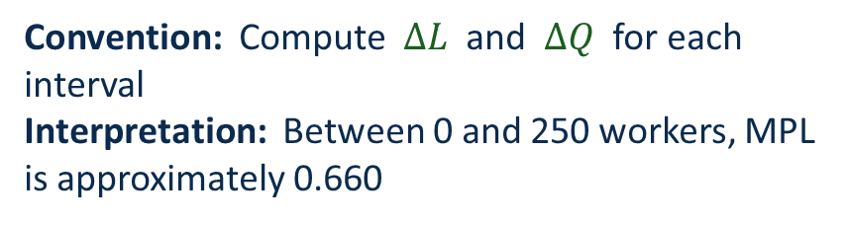
Module 3 · Short Run: Hiring Decisions
Marginal Product of Labor (MPL): Calculation
▪ Example: MPL from Rivian Production function
– Fix capital at $\overline{K}$ = 100
$${MP}_{L} = \frac{ΔQ}{ΔL}$$
L | K | Q | ΔQ | ΔL | MPL
0 | 100 | 0
250 | 100 | 165
500 | 100 | 204
1,000 | 100 | 251
1,500 | 100 | 283
2,000 | 100 | 309
2,500 | 100 | 330
165
250
0.660
39
250
0.156
Convention: Compute $ΔL$ and $ΔQ$ for each interval
Interpretation: Between 0 and 250 workers, MPL is approximately 0.660
47
500
0.094
32
500
0.064
26
500
0.052
21
500
0.042
Note: MPL is declining as we add workers
Management 405 · Module 3 · Production and Costs
4
Notes:
Now let's actually compute the marginal product of labor, step by step, with Rivian's numbers. We fix capital at 100 robots and walk the workforce up in stages. Take the very first step, from zero to 250 workers. Output rises from zero to 165 cars. So the change in output is 165, over a change in labor of 250 workers, and dividing one by the other gives a marginal product of about 0.66 cars per worker. That is the number in the box. Notice the convention we are using. We always measure each change against the previous row, not all the way back to zero. Now keep your eye on the marginal product column as we keep hiring. It falls from 0.66 to about 0.156 on the next step, then 0.094, then 0.064, and on down to roughly 0.042 cars per worker by the last group. Each additional worker is contributing less than the one before. That steadily falling column is diminishing marginal product of labor, in real numbers rather than as a theory.

Slide 5
Module 3 · Short Run: Hiring Decisions
Diminishing Marginal Product of Labor
We hold one input fixed (capital) and…
Use more and more of a variable input (labor)
Then total output will increase by less and less
i.e., the Marginal Product of Labor (MPL) goes down
➤ Very high MPL image
➤ Very low MPL image
Total output (rising, flattening)
Marginal Product of Labor (declining)
Note: MPL is plotted at the middle of each interval (per our convention)
plot the slope
Note: MPL is the slope (dQ / dL) of the output curve
Management 405 · Module 3 · Production and Costs
5
Notes:
Let's step back and see why that happens, and put it in a picture. When we hold capital fixed and keep adding more of a variable input like labor, total output still goes up. But it goes up by less and less each time. And less and less extra output is exactly what a falling marginal product means. On the left you can see total output rising and then flattening. The marginal product is really just the slope of that curve, how steep it is at each point. And that slope clearly gets gentler as we move to the right. On the right we plot the slope on its own, and it slides downward. The intuition is simple. Each new worker has to share the same fixed capital, the same machines and the same floor space. So each one adds a little less than the person before. This is not special to Rivian. It is the normal story in almost any short-run operation.

Slide 6
Module 3 · The Production Function
Do You See Diminishing MPL… and MPK?
Each curve flattens as L rises (diminishing MPL)
The vertical distance between curves narrows as K rises (diminishing MPK)
Management 405 · Module 3 · Production and Costs
6
Notes:
Here are those same numbers as a picture, which makes the pattern much easier to see. Each curve is total output as we add workers, and there is one curve for each level of robots, from 100 at the bottom up to 400 at the top. Look at any one curve on its own. It climbs quickly at first and then flattens out. That flattening is diminishing marginal product of labor, each extra worker adding less than the one before. Now look at the spacing between the curves. As we move from 100 robots to 200 to 300 to 400, the curves bunch closer together. So adding more robots also buys less and less extra output. That is diminishing marginal product of capital. This shape turns up everywhere, from a factory floor to a consulting team, so it is worth getting comfortable with it.

Slide 7
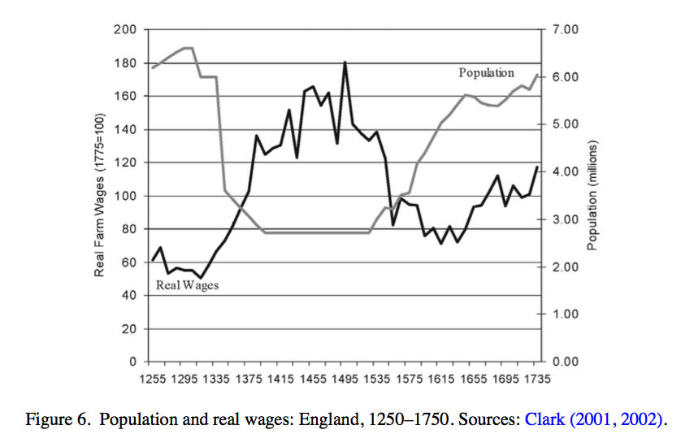
Module 3 · Short Run: Hiring Decisions
Famous Example for Diminishing Marginal Returns
The (agriculture-based) economy before 1800:
Land was the fixed factor; labor was variable
Q = f (labor, land); no capital
Wages and population, England 1300-1500
In 1348, the Black Death killed almost half the population (labor).
→ What happened to the return to labor?
Population
Return to labor
Management 405 · Module 3 · Production and Costs
7
Notes:
Here is a striking historical example of diminishing marginal product, running in reverse. Before about 1800, most economies were agricultural. Land was the fixed factor, labor was the variable one, and there was essentially no capital. Now think about what diminishing returns implies. If each extra worker on a fixed amount of land adds less than the one before, then taking workers away should do the opposite. The workers who remain become more productive at the margin. That is exactly what happened after 1348, when the Black Death killed roughly half the population in just a few years. With far fewer people working the same land, the marginal product of each surviving worker jumped. And the chart shows the consequence. As population collapsed, the wages of the survivors rose sharply. This is real-world proof of marginal-product reasoning, about 600 years before economists gave it a name.

Slide 8
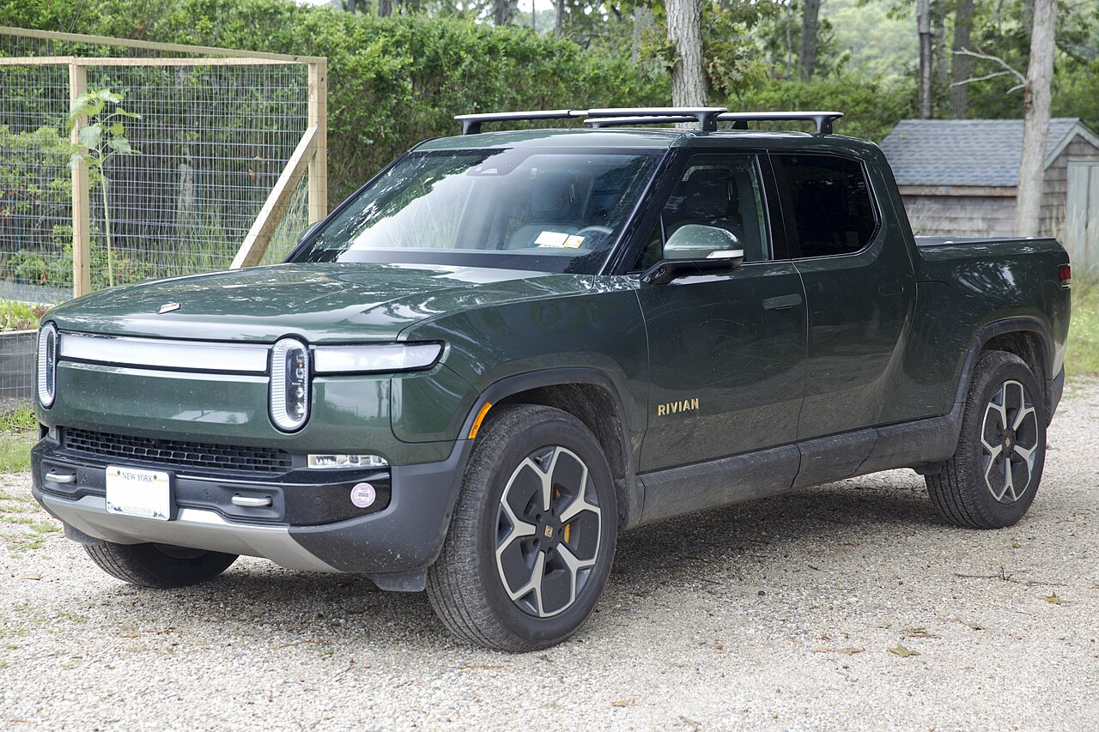
Module 3 · Short Run: Hiring Decisions
Hiring Decisions in the Short Run — Context & Scenario
Demand and output price are given
Large number of R1 ordered at price of ~$80k
Out of this, ~$35k is material cost → (Net) Revenue per car ~$45k
Short run: capital (factory size, robots) is fixed
The only way to expand production is to hire more workers
Rivian R1 (CC BY-SA, Wikimedia)
→ How many workers should Rivian optimally hire?
Management 405 · Module 3 · Production and Costs
8
Notes:
Now let's set up the hiring problem with a concrete scenario. Rivian has plenty of orders for the R1, and each one sells for about 80,000 dollars. Out of that price, roughly 35,000 dollars goes to materials. So the net revenue Rivian keeps from building one more car is about 45,000 dollars. Hold onto that 45,000 number, because we use it in a moment. We are in the short run, so the factory and the robots are fixed. The only lever Rivian can pull to build more cars is to hire more workers. So the question in front of us is simple to state. How many workers should Rivian hire? The next few slides build the answer.

Slide 9
Module 3 · Short Run: Hiring Decisions
Hiring Decisions in the Short Run — Core Concept
In the short run (capital K fixed):
MRPL = Marginal Revenue Product of Labor
the extra revenue from one more worker
Decomposition: MRPL = MR × MPL
MR: marginal revenue from selling an extra item
MPL: extra output (marginal product) from hiring one more worker
• When MPL falls, MRPL falls
• Decreasing MPL ⇒ marginal (additional) hires produce less and less additional output
• Price-taker case: MR = P, so MRPL = P × MPL
→ Even when holding MR (or price) constant, MRPL falls when labor is added, as a result of falling MPL
MB > MC
(of labor)
→ Hire more
Decision rule: If MRPL > w (wage), hire more workers
Management 405 · Module 3 · Production and Costs
9
Notes:
To decide how many workers to hire, we need one new tool, the marginal revenue product of labor, or MRPL. In plain terms, it is the extra revenue the firm earns from one more worker. It breaks into two pieces multiplied together. The first is the marginal product of labor, the extra cars one more worker produces, which we just studied. The second is the marginal revenue, the money the firm gets from selling one more car. For a firm that is small relative to the market, selling one more car does not move the price, so marginal revenue is just the price, and MRPL is simply the price times the marginal product. Here is what follows. We already know the marginal product falls as we add workers, so MRPL falls too. And that gives us the decision rule. Keep hiring as long as the extra revenue from a worker, the MRPL, is bigger than the wage you pay them, and stop when they are equal. If you step back, this is really the same marginal-benefit-equals-marginal-cost logic we keep coming back to, now applied to hiring.

Slide 10
Module 3 · Short Run: Hiring Decisions
Example: Calculate MRPL at 2,300 Employees and 100 Robots
K (robots)
Currently 100 robots and 2,300 employees on the R1 line
(Net) Revenue per car ~$45k
Assume that this is approx. constant
What is MRPL? (in $ per worker, per week)
 | 100 | 200 | 300 | 400
0 | 0 | 0 | 0 | 0
250 | 165 | 234 | 286 | 331
500 | 204 | 288 | 353 | 407
1,000 | 251 | 354 | 434 | 501
1,500 | 283 | 400 | 490 | 566
2,000 | 309 | 436 | 534 | 617
2,500 | 330 | 467 | 571 | 660
3,000 | 348 | 493 | 604 | 697
3,500 | 365 | 516 | 632 | 730
4,000 | 380 | 537 | 658 | 760
4,500 | 394 | 557 | 682 | 787
5,000 | 406 | 574 | 703 | 812
L (workers)
Production-function table (link)
Poll Break
Management 405 · Module 3 · Production and Costs
10
Notes:
Now let's put real numbers on it. Rivian is currently running the R1 line with 100 robots and about 2,300 workers. We keep the net revenue per car at roughly 45,000 dollars, and we treat that as constant here. The question is, what is the marginal revenue product of labor at this point? Here is how to approach it. First, find where 2,300 workers falls in our table. It sits inside the 2,000 to 2,500 interval, so that is the step we use for the marginal product. Then multiply that marginal product by the 45,000 dollars of net revenue per car. That gives MRPL in dollars per worker per week. On the next slide I'll ask you to actually compute it, so get ready to do that.

Slide 11
Module 3 · Short Run: Hiring Decisions
Solution: MRPL of Rivian
Check which interval contains the current workforce (L = 2,300)
→ use the 2,000 → 2,500 step
From the production-function table, at K=100:
Q (2,000) = 309 cars per week
Q (2,500) = 330 cars per week
Compute MPL = ΔQ / ΔL
MPL = (330 − 309) / 500 = 0.042 cars per worker per week
MRPL = MPL × MR
MR per car (net of material costs) is ≈ $45,000
→ Solution: MRPL = 0.042 × $45,000 = $1,890 per worker per week
Poll Break
Management 405 · Module 3 · Production and Costs
11
Notes:
Here is the answer worked through. We are in the 2,000 to 2,500 worker interval. From the production table at 100 robots, output goes from 309 cars at 2,000 workers to 330 cars at 2,500 workers. So the change in output is 21 cars over 500 extra workers, which is a marginal product of about 0.042 cars per worker per week. Now turn that into money. Each car brings in about 45,000 dollars of net revenue, so the marginal revenue product is 0.042 times 45,000, which comes to about 1,890 dollars per worker per week. So the twenty-three-hundredth worker adds roughly 1,890 dollars of revenue each week. Keep that number in mind, because on the next slide we compare it to the wage.

Slide 12
Module 3 · Short Run: Hiring Decisions
The Optimal Hiring Rule in the Short Run
Should Rivian hire more workers?
Suppose the weekly wage (incl. benefits) is $1,500 per worker
Hiring one more worker:
Revenue rises by MRPL (=$1,890)
Wage bill rises by w (=$1,500)
Profit rises whenever MRPL > w
Optimum: hire L* where MRPL = w
L*
MB = MC
(of labor)
Optimal Number of Workers: L* where: MRPL = w
Management 405 · Module 3 · Production and Costs
12
Notes:
Now we can state the rule cleanly. Suppose the weekly wage, including benefits, is about 1,500 dollars per worker. Think about hiring one more person. Revenue goes up by that worker's marginal revenue product, and costs go up by the wage. So profit rises as long as the marginal revenue product is bigger than the wage. You keep hiring until the two are equal. That point, where MRPL equals the wage, is the optimal number of workers, which we call L-star. And once again, this is the marginal-benefit-equals-marginal-cost idea, now for the hiring decision. The benefit of one more worker is the revenue they bring in, the cost is their wage, and you push to the point where those two balance.

Slide 13

Module 3 · Short Run: Hiring Decisions
Optimal Hiring Rule in the Short Run: Numerical Solution
▪ Compute MRPL for each L-interval at K=100 (0-250, 250-500, 500-1,000…)
L | K | Q | ΔQ | ΔL | MPL | MRPL
0 | 100 | 0
250 | 100 | 165
500 | 100 | 204
1,000 | 100 | 251
1,500 | 100 | 283
2,000 | 100 | 309
2,500 | 100 | 330
3,000 | 100 | 348
3,500 | 100 | 365
4,000 | 100 | 380
4,500 | 100 | 394
5,000 | 100 | 406
Wage
165
250
0.660
$29,700
$1,500
39
250
0.156
$7,020
$1,500
47
500
0.094
$4,230
$1,500
32
500
0.064
$2,880
$1,500
26
500
0.052
$2,340
$1,500
21
500
0.042
$1,890
$1,500
18
500
0.036
$1,620
$1,500
17
500
0.034
$1,530
≈
$1,500
Optimal hiring falls into the interval between 3,000 and 3,500 workers
15
500
0.030
$1,350
$1,500
14
500
0.028
$1,260
$1,500
12
500
0.024
$1,080
$1,500
MB ≈ MC
(of labor)
$$MRPL = \$45,000 × MPL$$
Management 405 · Module 3 · Production and Costs
13
Notes:
Here we do the whole calculation as a table. For every step in the workforce, we take the marginal product and multiply it by the 45,000 dollars of net revenue to get the marginal revenue product, shown in the MRPL column. Look at the first interval. The marginal product there is 0.66 cars per worker, so the marginal revenue product is a large 29,700 dollars per worker. That is far above the 1,500 dollar wage, so of course we hire. But watch the MRPL column fall as we add workers, 7,020, then 4,230, and on down through the thousands. On the right we line up the wage, a flat 1,500 dollars for every worker. The rule says keep hiring while MRPL is above the wage, and stop when it drops below. Tracing down the column, that crossover happens in the interval between 3,000 and 3,500 workers. So the optimal workforce is right around there. That is L-star, the point where the marginal revenue product has fallen to meet the wage, which is our marginal-benefit-equals-marginal-cost condition in numbers.

Slide 14
BACKUP
Management 405 · Module 3 · Production and Costs
14

Slide 15
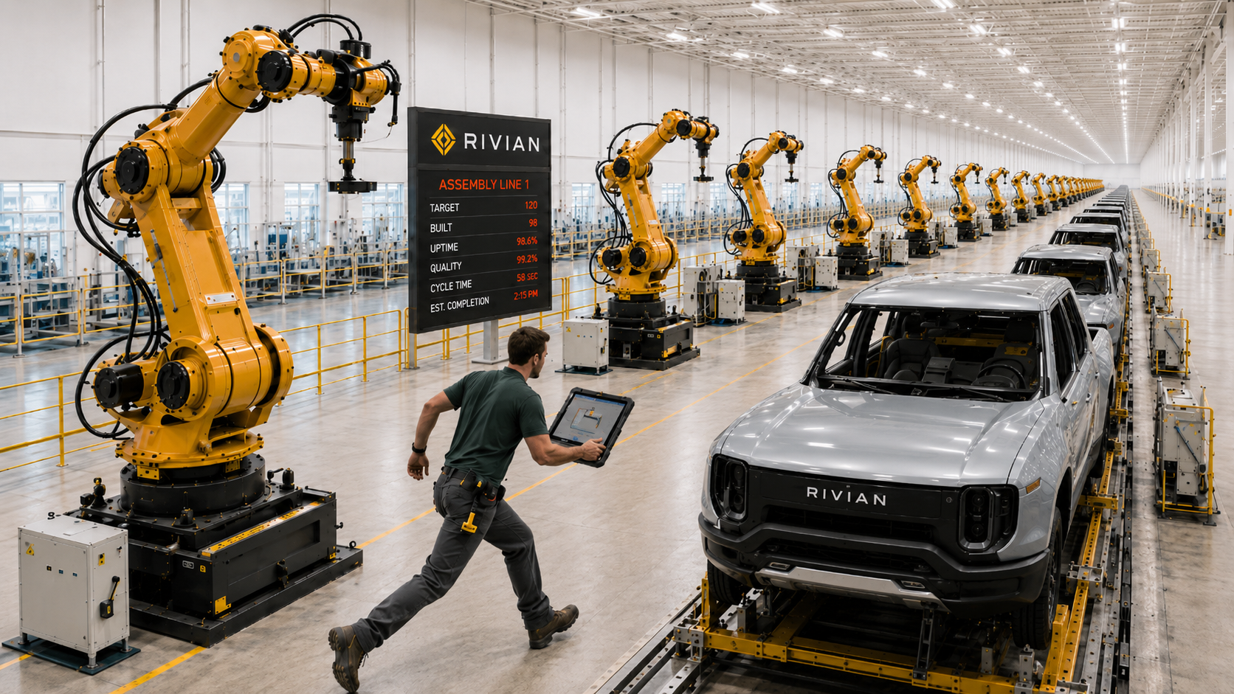
Very High MPL in the Rivian Plant
← Back
Notes:
This is a backup slide, showing what a very high marginal product of labor looks like in practice. It is the very start of Rivian's hiring ramp, where the plant has plenty of idle capital and only a few workers. In that situation each additional worker adds a lot of output, because there is so much equipment for them to work with. It is the steep part at the left of the production curve. The button in the corner takes us back.

Slide 16

Very Low (or negative) MPL in the Rivian Plant
← Back
Notes:
This is the companion backup slide, showing the opposite case, a very low or even negative marginal product of labor. Here the plant is already saturated with workers, all sharing the same fixed capital, so one more person adds almost nothing, and can even get in the way. It is the flat tail at the right of the production curve. Again, the button in the corner returns us to where we were.

